Slide 1


AGRILINK
AgriLink
Empowering African Farmers Through Digital Agriculture
End-to-End Digital Ecosystem Connecting Farms to Markets

Slide 2
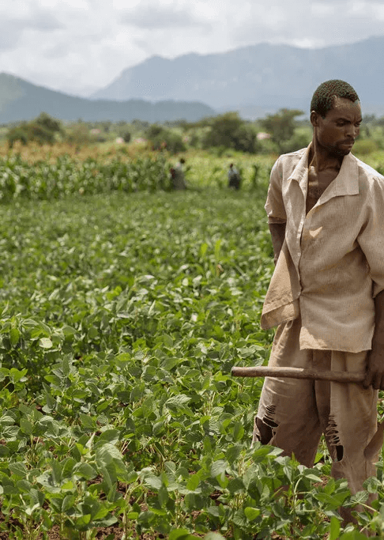
THE PROBLEM — SMALLHOLDER FARMER CRISIS
Millions of African Farmers Are Trapped in Poverty
🚫 Limited and unreliable market access
💰 Exploitative middlemen and price opacity
📊 Poor farm planning and inventory management
🚜 Lack of affordable logistics, storage, equipment, and certified inputs
Meanwhile, buyers struggle with inconsistent supply, quality uncertainty, and high sourcing costs.

Slide 3
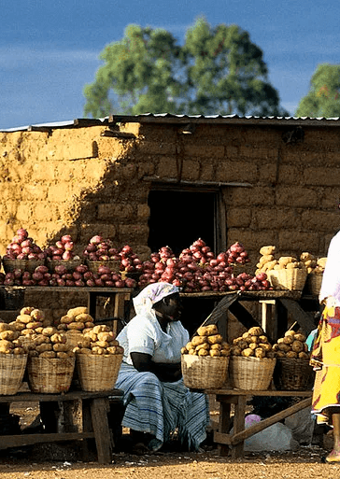



THE SOLUTION — AGRILINK PLATFORM
AgriLink — Complete Digital Agriculture Ecosystem
Connecting farmers directly to markets while digitizing the entire farming value chain
Marketplace
Farm Management
Services
Direct farmer‑to‑buyer connections
Digital planning, tracking, and insights
Logistics, equipment, storage, inputs
Accessible via mobile app and USSD for low‑connectivity environments

Slide 4
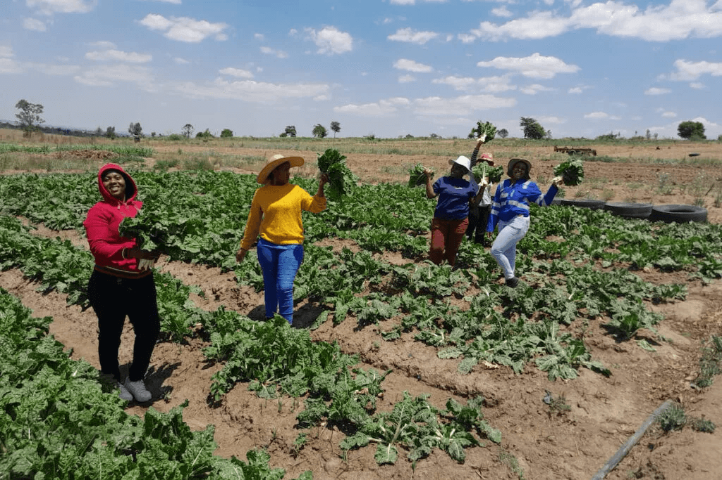
Key Partners Ecosystem
Farmers' cooperatives & associations
Agro-input suppliers (seed, fertilizer, equipment)
Buyers & distributors (supermarkets, exporters, wholesalers)
Logistics & transportation companies
Mobile payment providers (M-Pesa, Unicoin)
Agronomists & training institutions
Insurance companies & microfinance providers
Government agricultural boards & NGOs

Slide 5
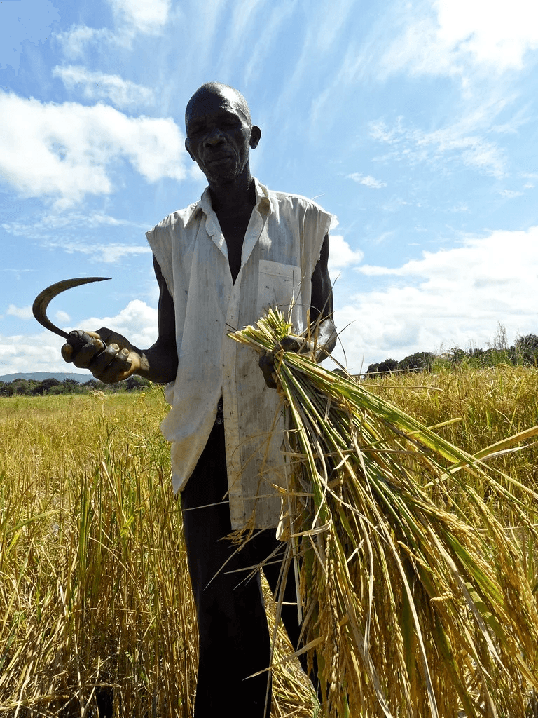



PRODUCT OVERVIEW — FARMER PROFILE & DASHBOARD
Farmer-Centered Digital Platform
a) Farmer Profile & Digital Identity
b) My Farm Dashboard
Farm size & active crops
Verified farmer profiles
Growth stage tracking
Capture Farm location, crops.
Expected yields
Transaction & production history
Designed for simplicity and quick field use by agents and farmers.

Slide 6
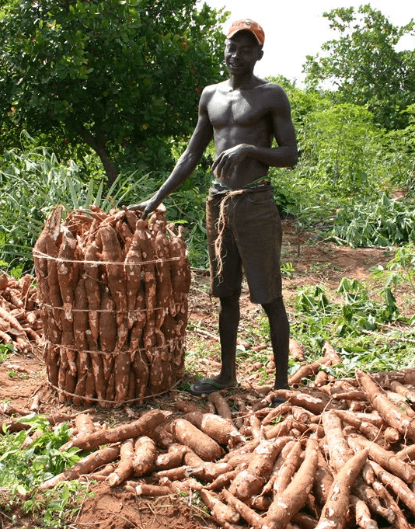
PRODUCT OVERVIEW — INVENTORY & CROP CALENDAR
Smart Inventory Management & Planning
(c) Inventory & Product Listings
• Available stock
• Reserved vs ready to sale
• Live product listings for buyers
(d) Harvest Date & Crop Calendar
• Crop specific planting dates & harvest timelines
• Input schedules (fertilizer & insecticides)
• Weather & agronomy alerts
This reduces guesswork and improves farm productivity.

Slide 7




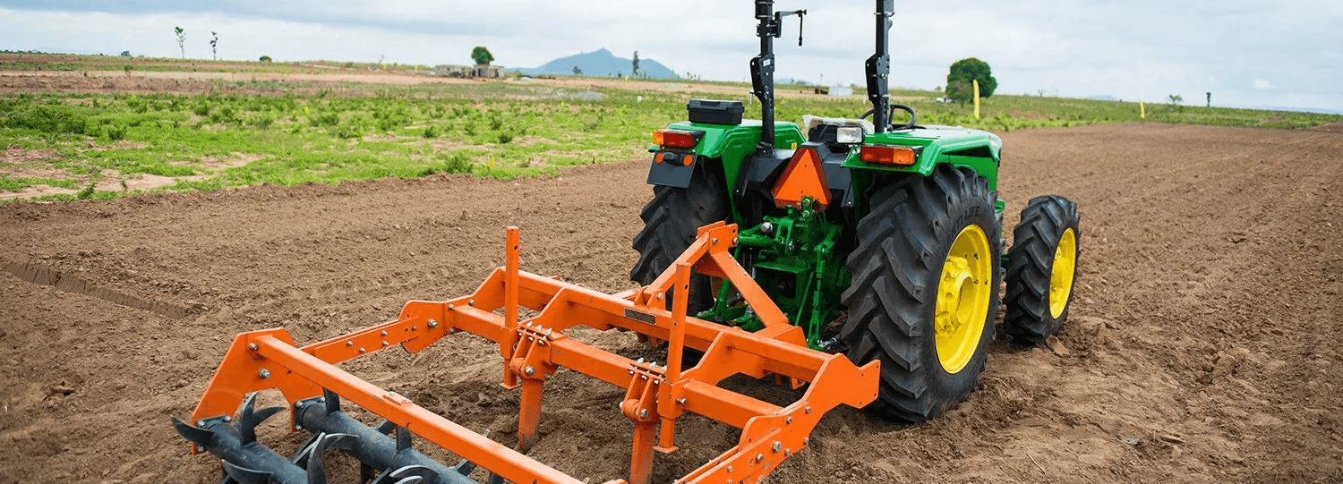
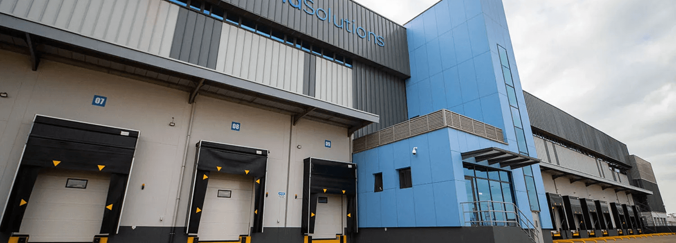
INTEGRATED SERVICES MARKETPLACE
Removing Operational Barriers
All services discoverable, bookable, and trackable inside the app
Logistics
Cold Storage
Equipment Rental
Inputs Marketplace
Transport booking & tracking
Reduce post‑harvest loss
Tractors, irrigation, tools
Certified seeds & fertilizers
Beyond selling produce, AgriLink removes operational barriers.
This directly reduces post harvest losses and operational costs.
Equipment Rental in Action
Cold Storage & Warehousing

Slide 8
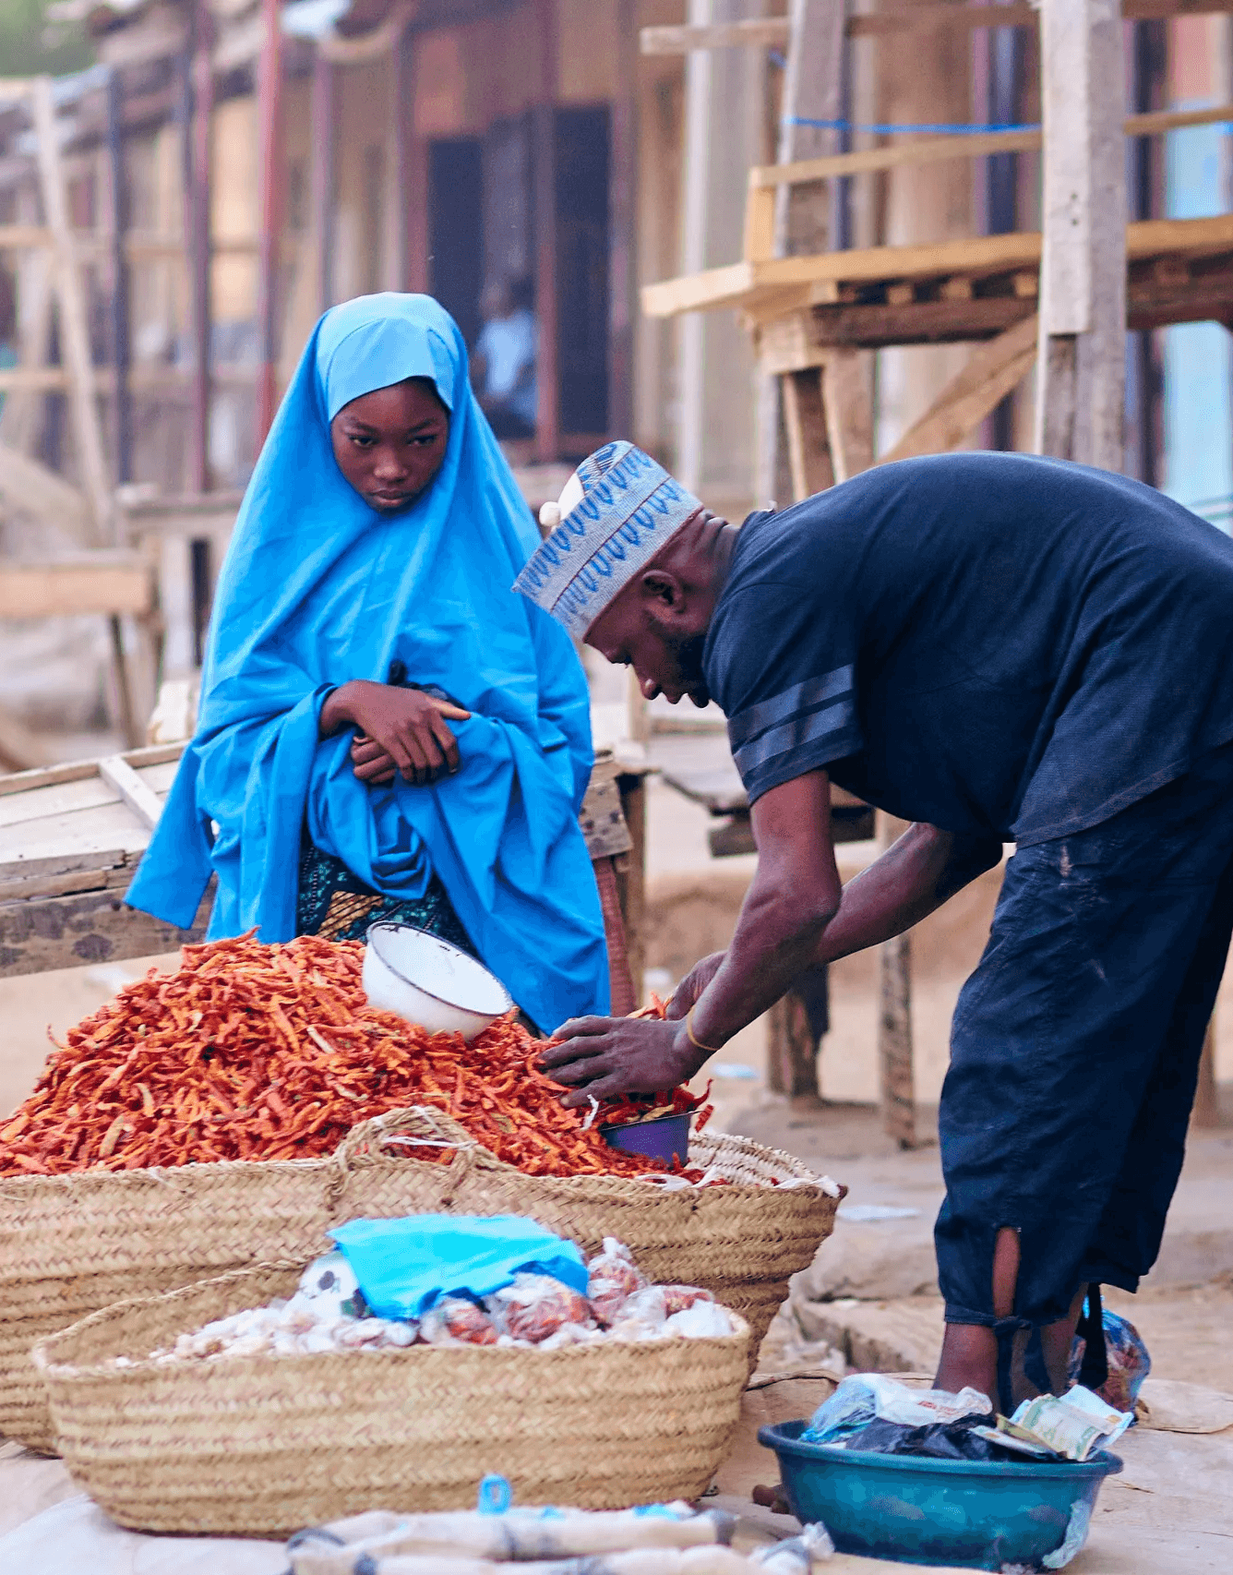
HOW IT WORKS
Simple 5‑Step Process
1
Register
Farmer registers (App / USSD)
2
Setup
Farm profile, crops, inventory & harvest dates
3
Connect
Buyers browse, pre‑book, or place orders
4
Arrange
Logistics & storage via platform
5
Get Paid
Secure digital payments to farmers

Slide 9
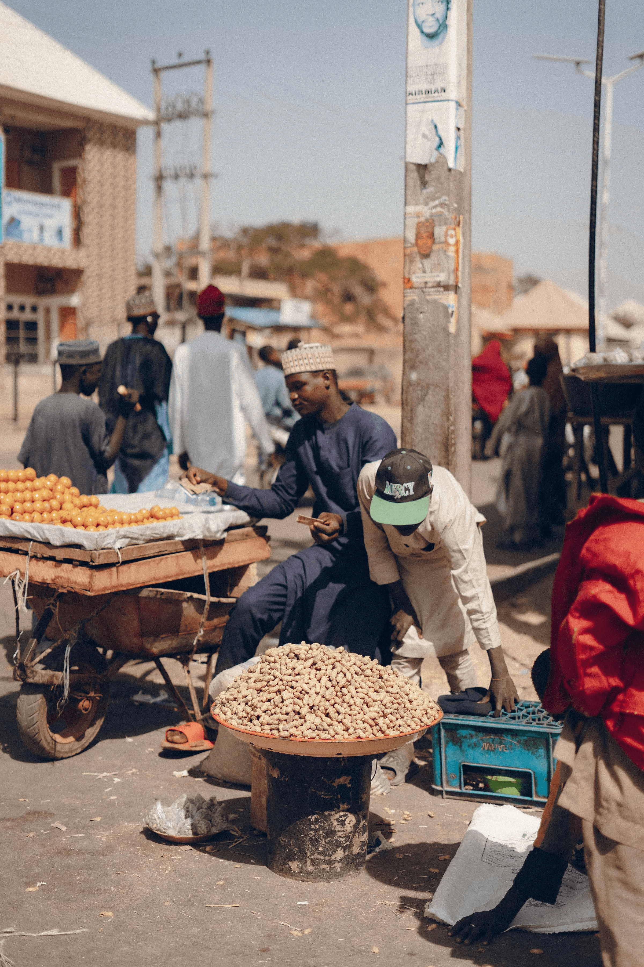
Value Propositions — For Buyers & Partners
For Buyers
For Partners
Verified and quality produce sourcing
Access to verified farmer networks
Bulk purchase and supplier matching
Insights from aggregated agricultural data
Transparent pricing & traceability

Slide 10
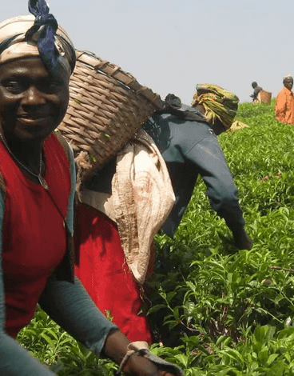

TARGET MARKET
Large Addressable Market
Primary
Secondary
🌾 Smallholder farmers
🏭 Food processors
🌾 Medium‑scale farmers
🏨 Hotels & restaurants
🌍 Exporters & retailers
Geographic Focus
Initial: Tanzania
Expansion: East Africa

Slide 11



BUSINESS MODEL
Multiple Revenue Streams
Transaction Commissions
Subscription Plans
3–7% per sale
For buyers & service providers
Marketplace Margins
Data Insights
Inputs & equipment sales
Agri-partnerships & analytics
This diversified model ensures sustainability while keeping the platform affordable for farmers.

Slide 12
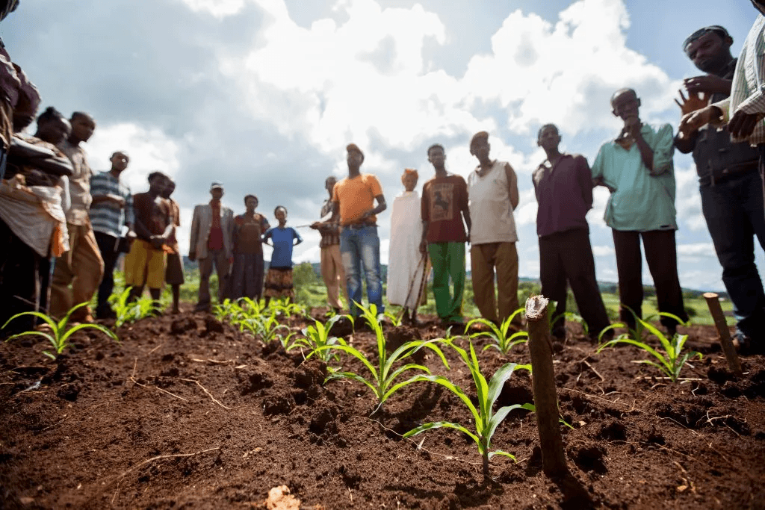

COMPETITIVE ADVANTAGE
Why AgriLink Wins
Full-stack solution (not just a marketplace)
Designed for low-connectivity environments
Multiple daily-use features → high retention
Strong local partnerships
Scalable crop & region model
We’re building infrastructure, not just an app

Slide 13







IMPACT
Transforming Lives & Communities
Higher farmer incomes
Reduced post‑harvest losses
Improved food security
Youth employment in agri‑tech
Financial inclusion via transaction histories
“Building resilient food systems across Africa.”

Slide 14

VISION
Our Ambitious Vision
“To become Africa’s leading digital agricultural infrastructure, powering farm productivity, market access, and resilient food systems.”

Slide 15
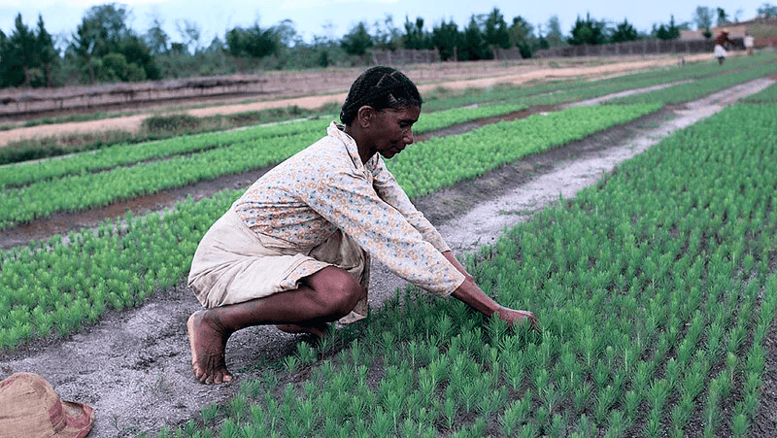
Impact
Transforming African Agriculture:
• Empowering smallholder farmers
• Creating transparent value chains
• Driving economic growth in rural areas
• Building sustainable food systems

Slide 16



THE ASK
Join Us in Transforming African Agriculture
Seed / Pre‑seed Investment
Pilot Partners
Fuel product, pilots, and early scale.
• Buyer organizations
• Farmer cooperatives
Strategic Partnerships
Logistics & transportation
Agricultural inputs suppliers
Fintech & mobile payments
Let’s build the future together
Contact: info@nyikainnovations.co.tz

Slide 17
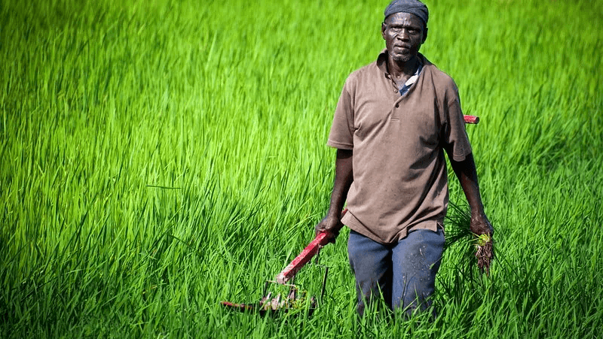






THANK YOU / CONTACT
Let’s Connect
Primary Contact
Website & App
{Rolland Robert | FOUNDER
www.nyikainnovations.co.tz
iOS
Android
Phone: +255686600166 | Email: Rolland@nyikainnovations.co.tz
Social
Investor Inquiries
LinkedIn: @
X: @
info@nyikainnovations.co.tz
Facebook: @
Empowering Africa’s farmers, one digital connection at a time

